Slide 1
INVESTIGATION INTO THE DIFFERENCES BETWEEN MONTREAL AND VANCOUVER
Rachel Munro

Slide 2
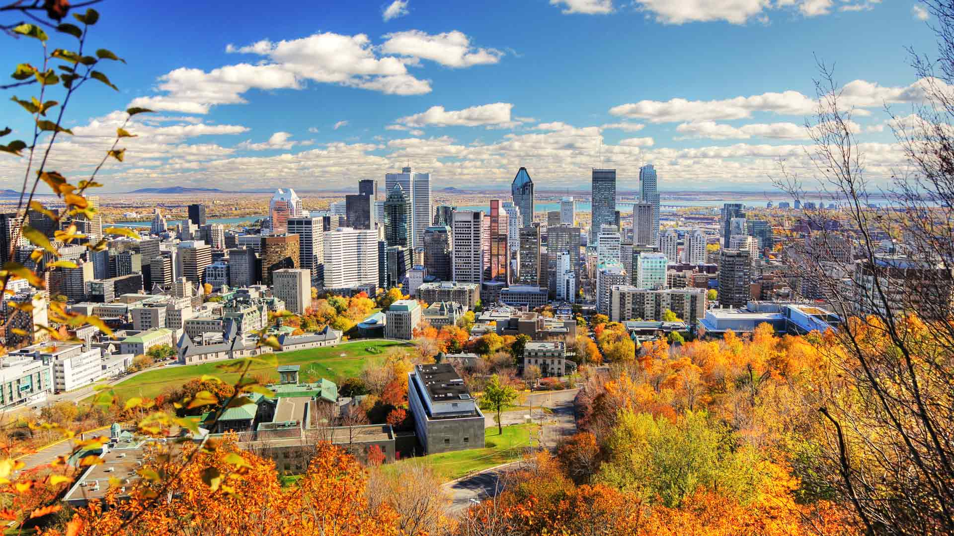
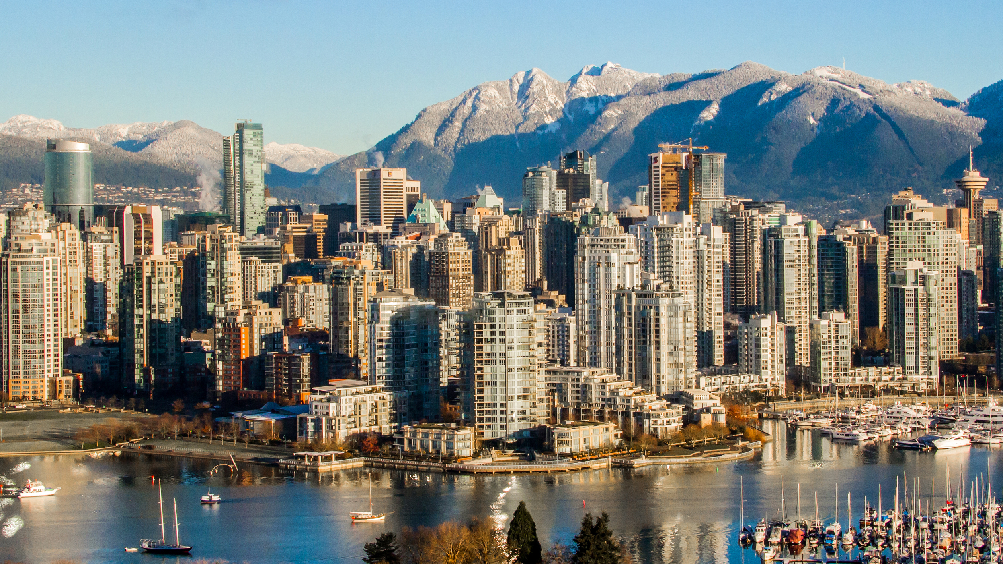
Introduction
Montreal
Two of the most populated cities in Canada, apart from Toronto, are Montreal and Vancouver.
Both cities are very multicultural, have hosted the Olympics, and are both homes to large universities, industry, and world-class attractions
Located at opposite sides of this vast country they have drastically different cultural identities and local attractions.
Montreal is Canada’s oldest established city and was originally founded in 1642 and boasts a large francophone community.
Vancouver, in contrast, was founded much later in 1867 and hosts a large population of immigrants from eastern Asia.
https://www.outfrontmedia.ca/find-your-market/montreal
Vancouver
https://daily.sevenfifty.com/48-hours-in-vancouver-with-rhys-pender/

Slide 3
Problem
Given how culturally and historically different Montreal and Vancouver are, it would be interesting to look at the similarities and differences between these two cities based on:
Popular amenities
Rental prices
Age distribution
Household income
Immigrant country of origin

Slide 4
Data Sources
Montreal
Neighbourhood designations, area, population, and average monthly rent: https://en.wikipedia.org/wiki/Montreal.
GeoJSON: https://github.com/blackmad/neighborhoods/blob/master/gn-montreal.geojson.
2016 Census: https://www12.statcan.gc.ca/census-recensement/2016/dp-pd/prof/details/page.cfm?Lang=E&Geo1=CMACA&Code1=462&Geo2=PR&Code2=01&Data=Count&SearchText=Montreal&SearchType=Begins&SearchPR=01&TABID=1&B1=All).
Vancouver
Neighbourhood designations for the 22 districts in Vancouver were taken from: https://en.wikipedia.org/wiki/List_of_neighbourhoods_in_Vancouver.
Area, population and average monthly rent were taken from https://vancouver.ca/news-calendar/areas-of-the-city.aspx.
GeoJSON: https://opendata.vancouver.ca/explore/dataset/local-area-boundary/information/ .
2016 Census: https://www12.statcan.gc.ca/census-recensement/2016/dp-pd/prof/details/page.cfm?Lang=E&Geo1=CSD&Code1=5915022&Geo2=PR&Code2=01&Data=Count&SearchText=5915022&SearchType=Begins&SearchPR=01&B1=All&Custom=&TABID=3

Slide 5
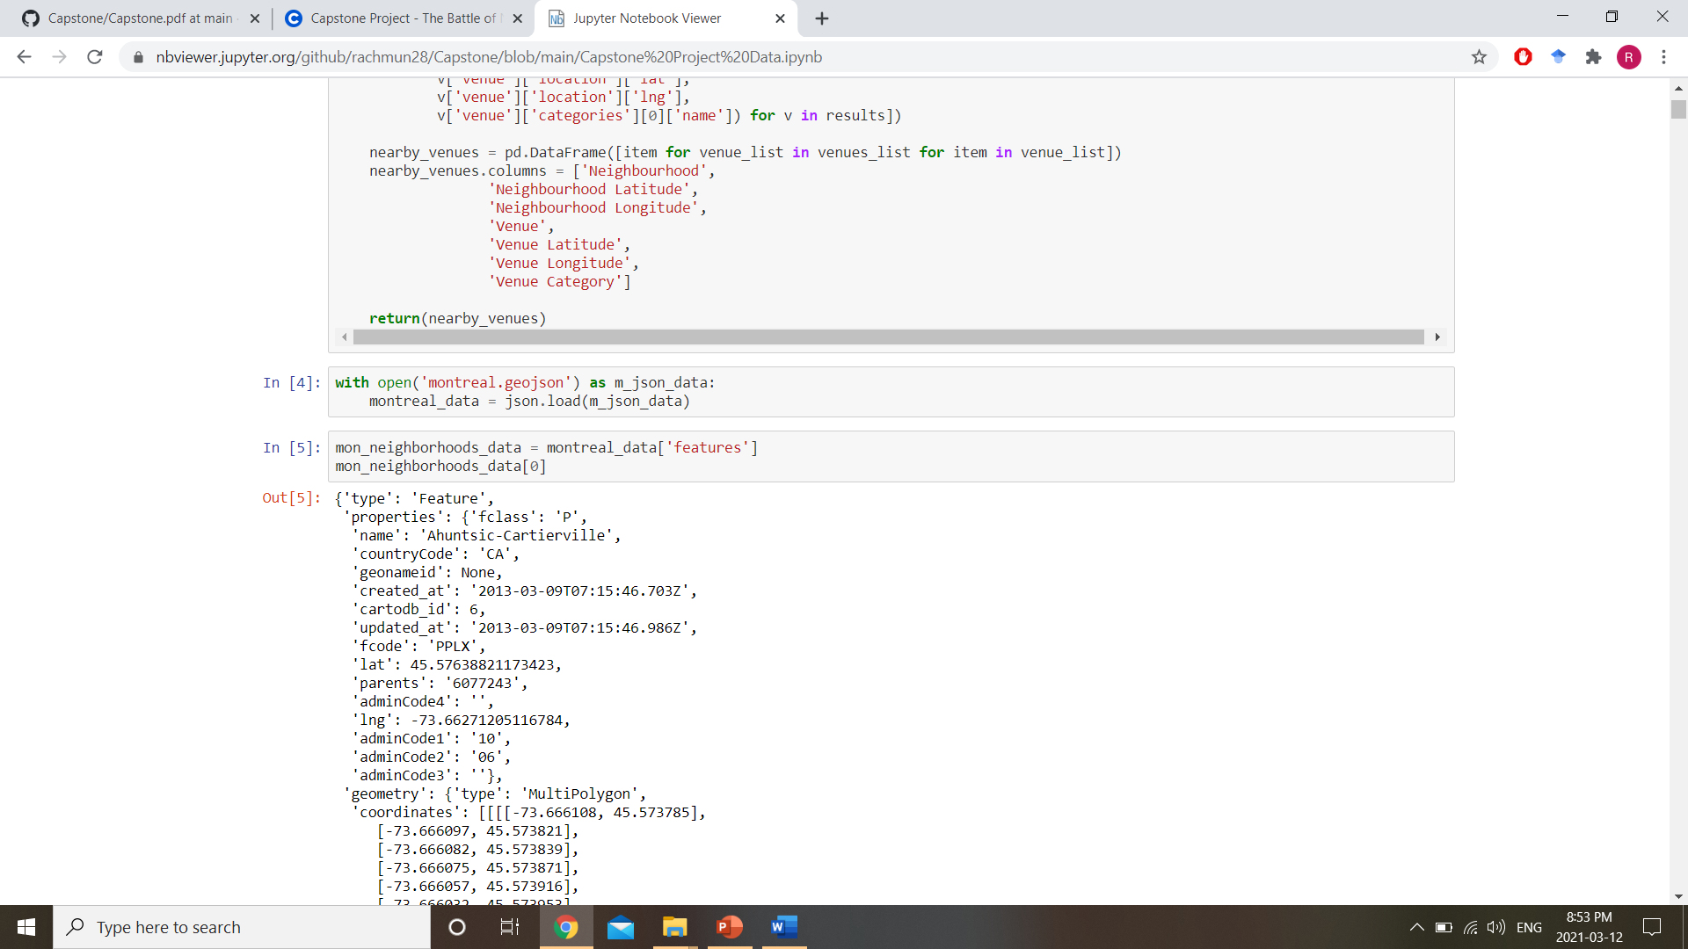
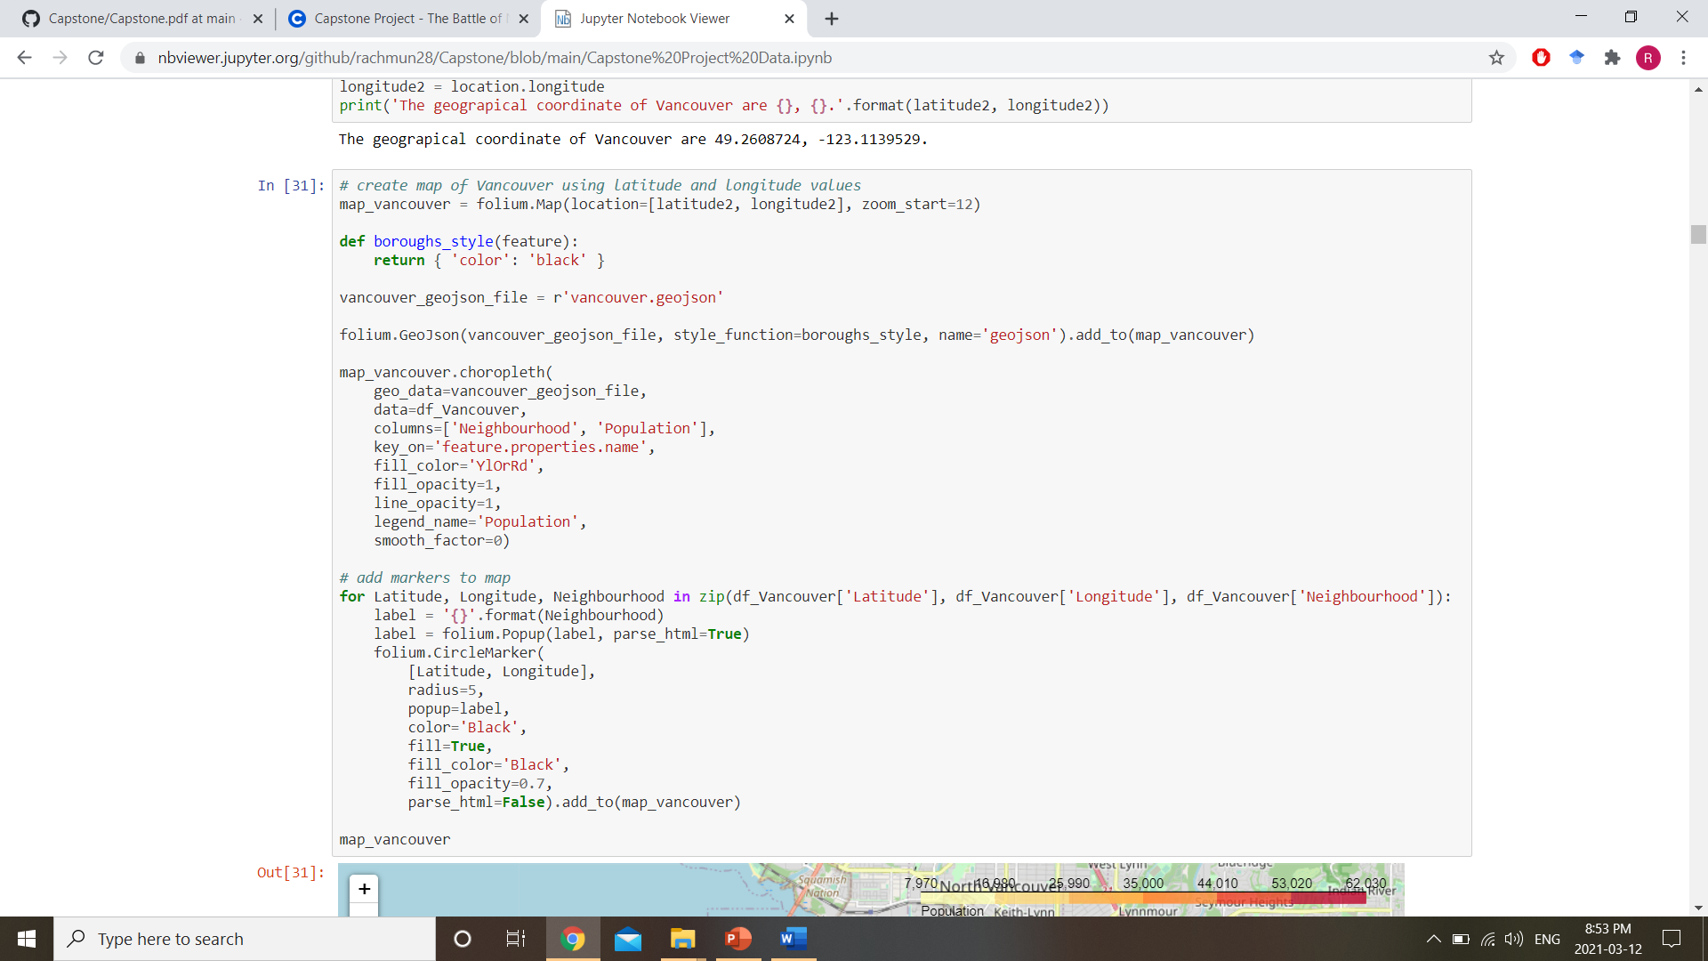
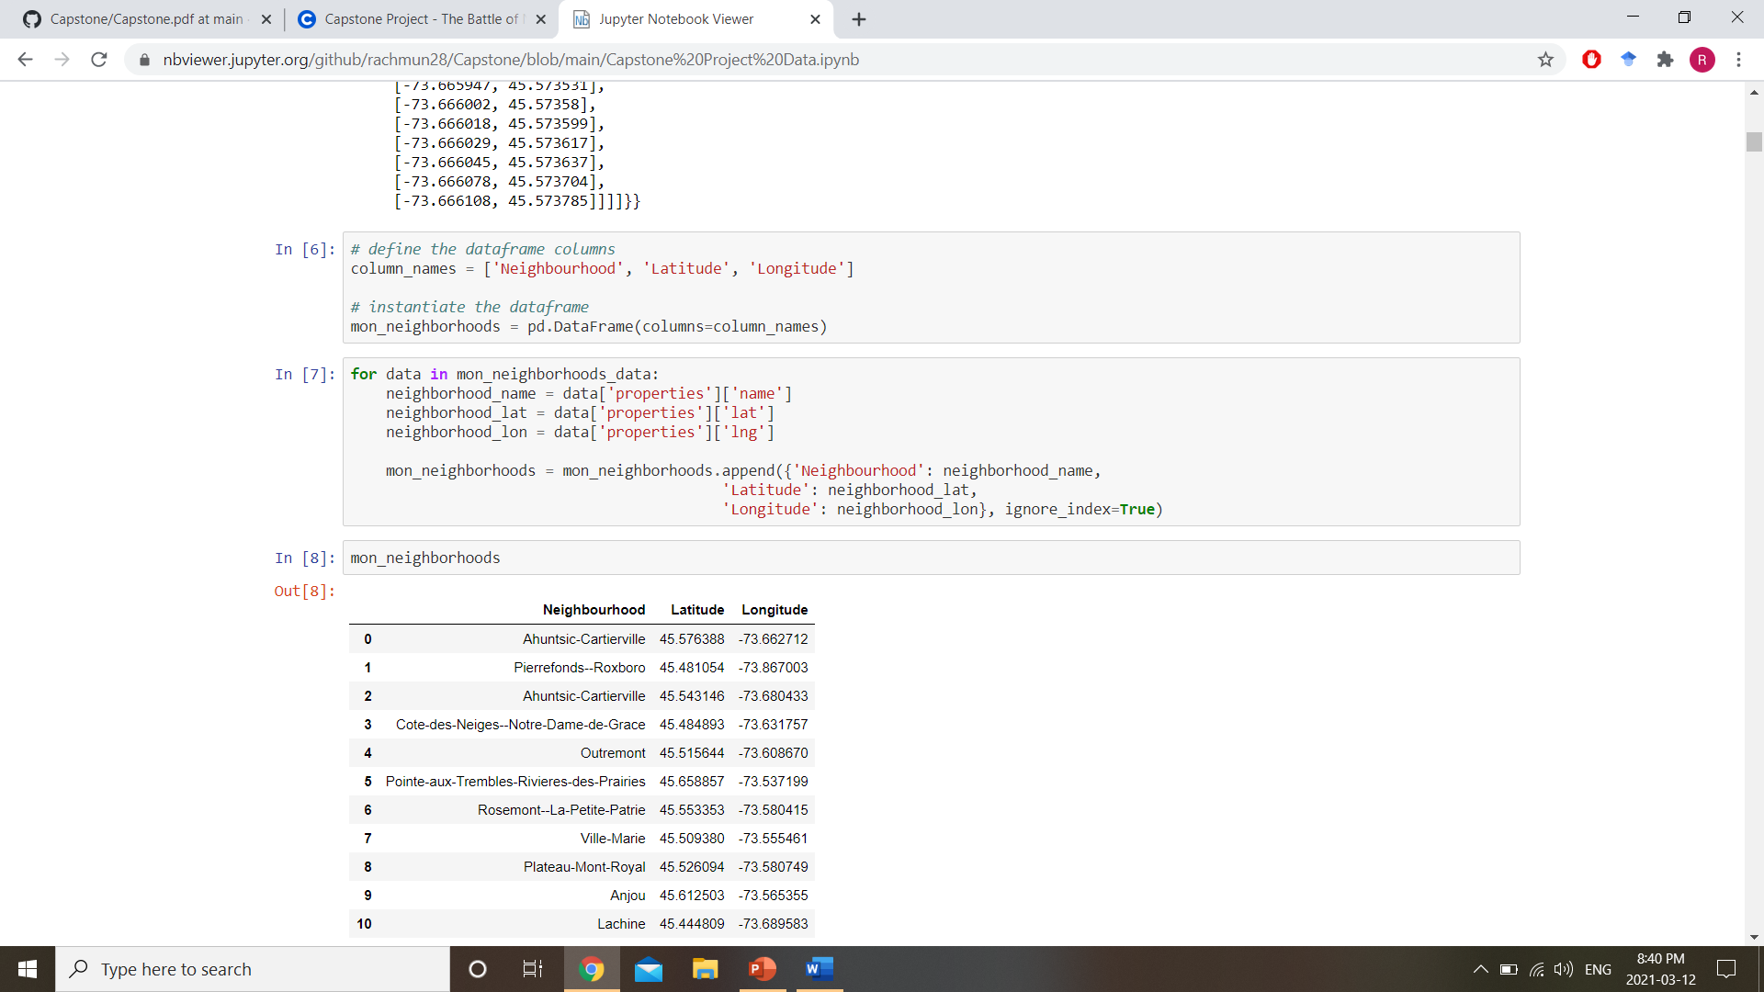
Importing GEOJSON Files and Creating Maps

Slide 6
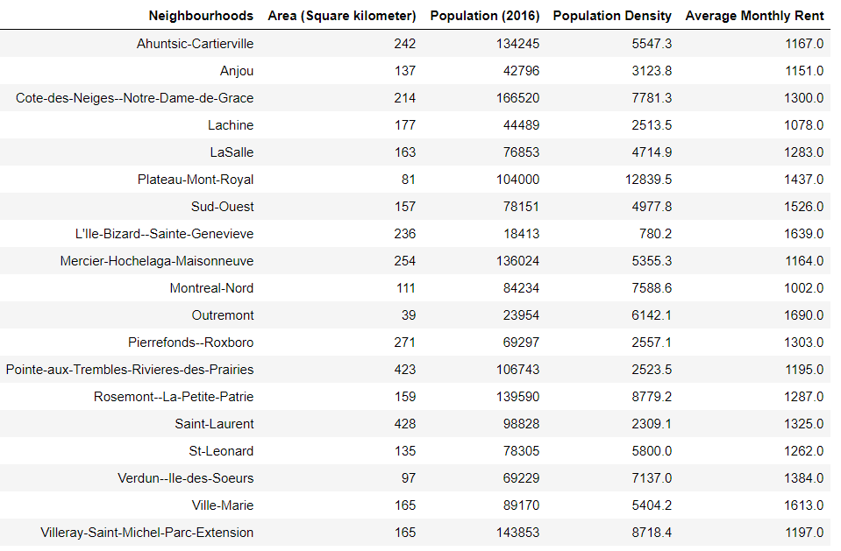
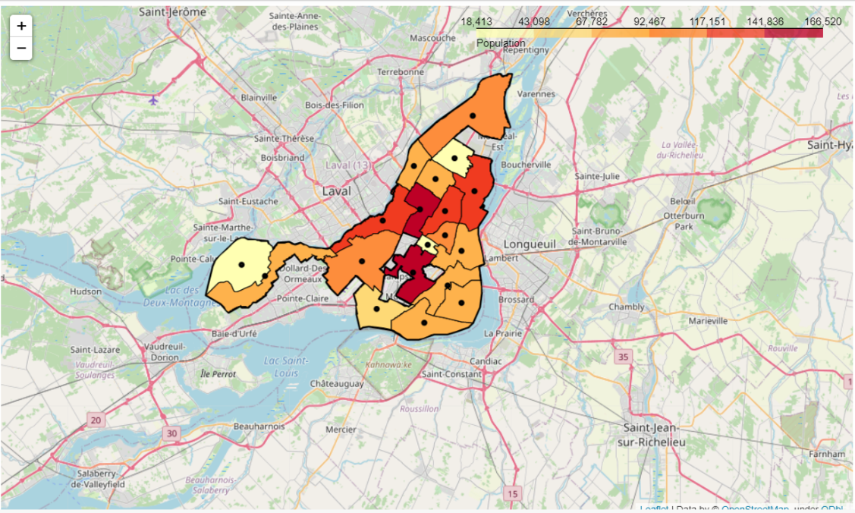
Montreal

Slide 7
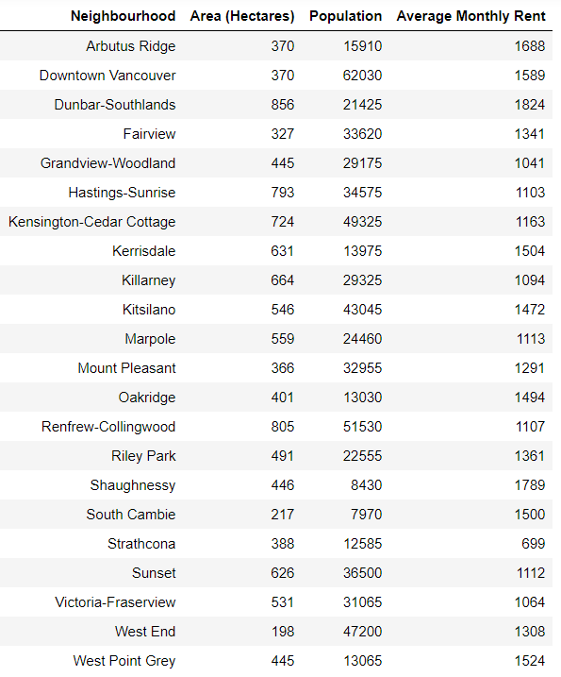
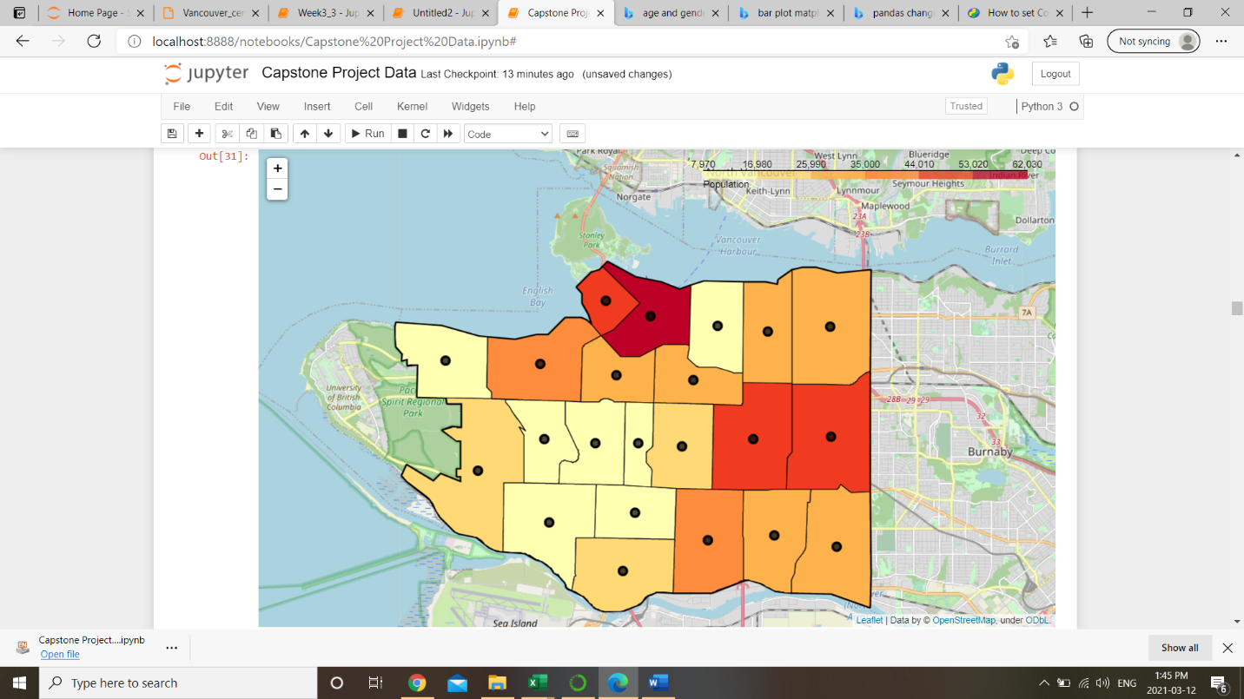
Vancouver

Slide 8
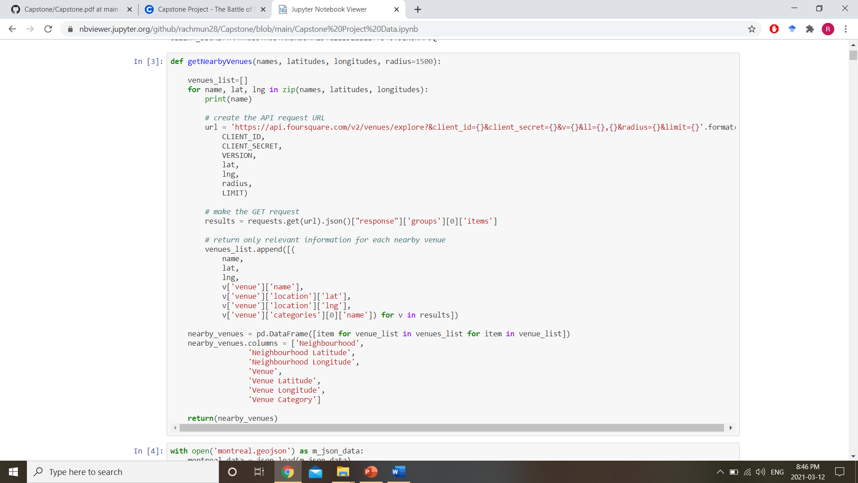
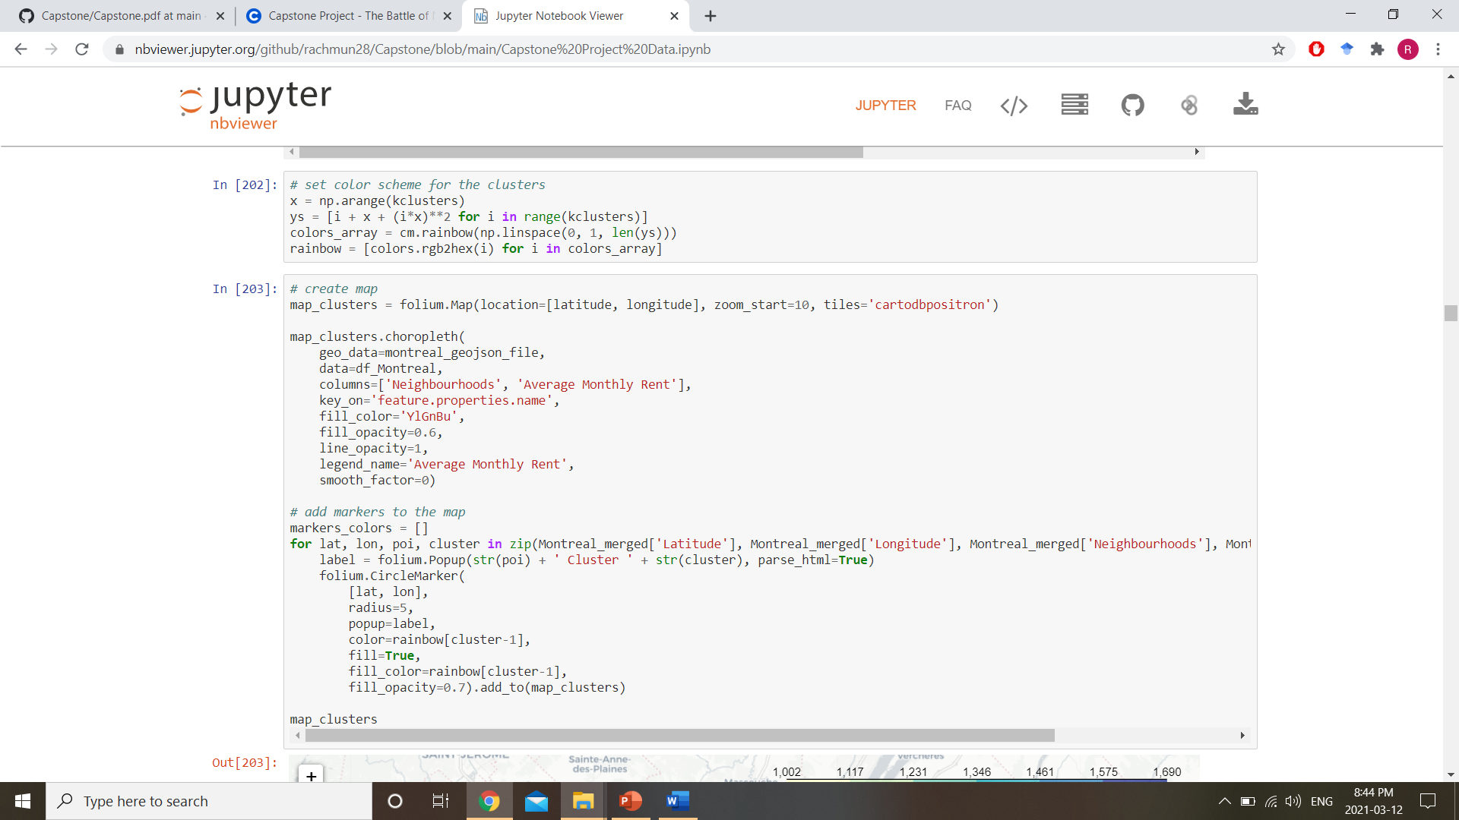
Getting Nearby Venues VIA FOURSqUARE

Slide 9
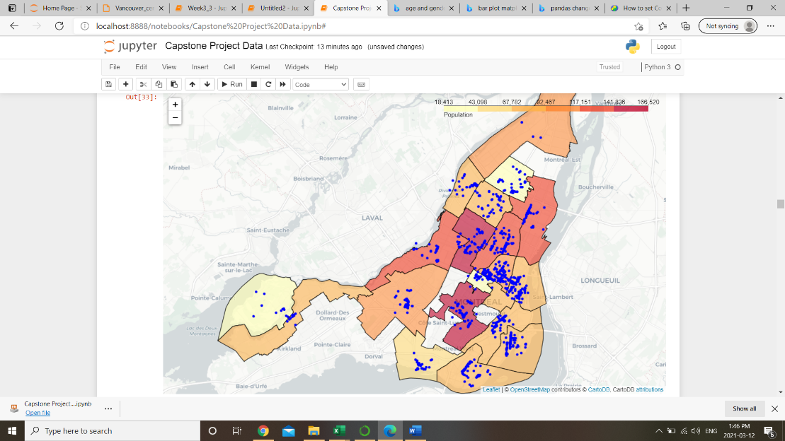
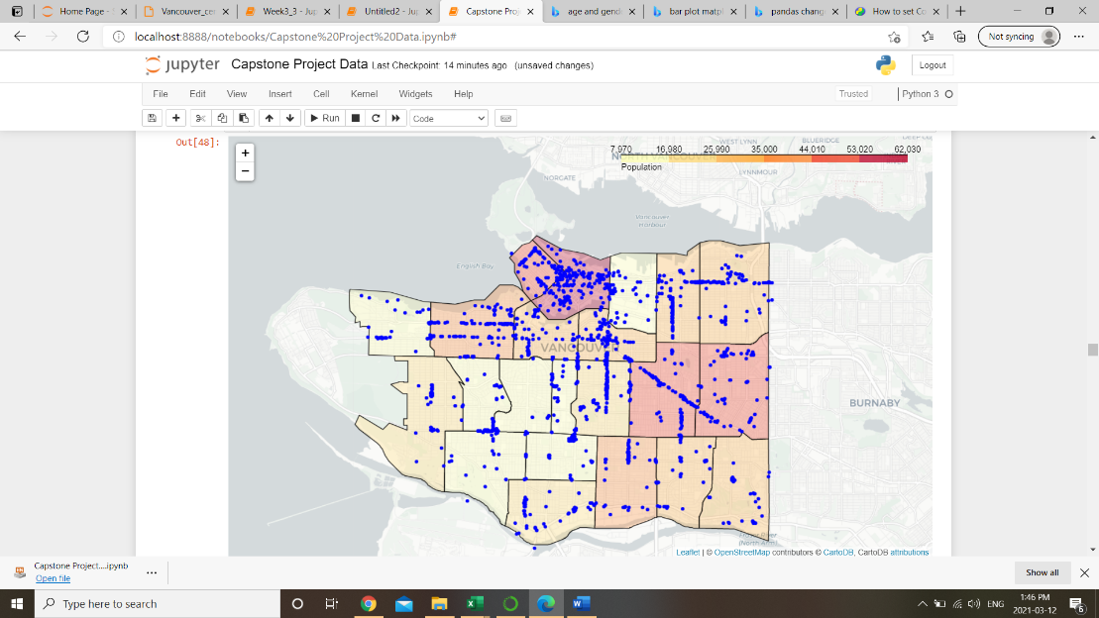
Popular Venues From Foursquare data
(a) (b)
Figure 3. Neighbourhoods of (a) Montreal and (b) Vancouver coloured according to population in 2016 overlaid with popular venues as derived from Foursquare API data.

Slide 10
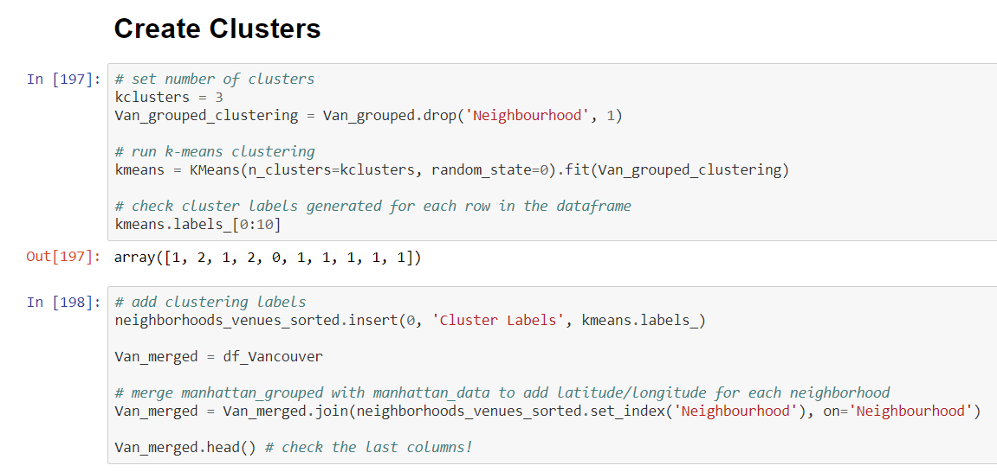
Creating CLusters

Slide 11
Montreal Clustered Location Data
Neighbourhoods | Average Monthly Rent | Cluster Labels | 1st Most Common Venue | 2nd Most Common Venue | 3rd Most Common Venue | 4th Most Common Venue | 5th Most Common Venue | 6th Most Common Venue | 7th Most Common Venue | 8th Most Common Venue | 9th Most Common Venue | 10th Most Common Venue
Pointe-aux-Trembles-Rivieres-des-Prairies | 1195 | 0 | Bakery | Convenience Store | Restaurant | Auto Dealership | English Restaurant | Flea Market | Fish Market | Fish & Chips Shop | Fast Food Restaurant | Farmers Market
Ahuntsic-Cartierville | 1167 | 1 | Park | Pharmacy | Grocery Store | Restaurant | Pizza Place | New American Restaurant | Farmers Market | Fast Food Restaurant | Seafood Restaurant | Breakfast Spot
Verdun--Ile-des-Soeurs | 1384 | 1 | Park | Pizza Place | Cafe | Bank | Sandwich Place | Mediterranean Restaurant | Indian Restaurant | Trail | BBQ Joint | Grocery Store
St-Leonard | 1262 | 1 | Pharmacy | Gas Station | Italian Restaurant | Sandwich Place | Drugstore | Fast Food Restaurant | Bank | Bakery | Sports Bar | Gastropub
Saint-Laurent | 1325 | 1 | Sporting Goods Shop | Hotel | Breakfast Spot | Bank | Restaurant | Sandwich Place | Fast Food Restaurant | Liquor Store | Shipping Store | Shoe Store
Rosemont--La-Petite-Patrie | 1287 | 1 | Park | Pharmacy | Bar | Breakfast Spot | Pizza Place | Bakery | Italian Restaurant | Grocery Store | Restaurant | Brewery
Pierrefonds--Roxboro | 1303 | 1 | Pizza Place | Restaurant | Convenience Store | Grocery Store | Park | Pharmacy | Skating Rink | Breakfast Spot | Food & Drink Shop | French Restaurant
Outremont | 1690 | 1 | Cafe | Bakery | Bar | Mediterranean Restaurant | Restaurant | French Restaurant | Bagel Shop | Supermarket | Breakfast Spot | Park
Ville-Marie | 1613 | 1 | Cafe | Hotel | Cocktail Bar | Plaza | Bar | Spa | Restaurant | Tea Room | Coffee Shop | Hostel
Montreal-Nord | 1002 | 1 | Pharmacy | Italian Restaurant | Grocery Store | Breakfast Spot | Restaurant | Supermarket | Gas Station | Fast Food Restaurant | Portuguese Restaurant | Video Game Store
Sud-Ouest | 1526 | 1 | Bakery | Cafe | Breakfast Spot | Restaurant | French Restaurant | Ice Cream Shop | Pizza Place | Brewery | Bar | Gastropub
Plateau-Mont-Royal | 1437 | 1 | Cafe | Bakery | Restaurant | Park | Vegetarian / Vegan Restaurant | Portuguese Restaurant | Yoga Studio | Coffee Shop | Deli / Bodega | Middle Eastern Restaurant
LaSalle | 1283 | 1 | Fast Food Restaurant | Breakfast Spot | Pizza Place | Pharmacy | Restaurant | Coffee Shop | Italian Restaurant | Gym / Fitness Center | Sandwich Place | Pet Store
Lachine | 1078 | 1 | Park | Italian Restaurant | Pharmacy | Fast Food Restaurant | Ice Cream Shop | Bank | Liquor Store | Lighthouse | Sandwich Place | Restaurant
Cote-des-Neiges--Notre-Dame-de-Grace | 1300 | 1 | Coffee Shop | Pharmacy | Bakery | Vietnamese Restaurant | Fast Food Restaurant | Restaurant | Bank | Liquor Store | Pizza Place | Grocery Store
Anjou | 1151 | 1 | Coffee Shop | Clothing Store | Restaurant | Fast Food Restaurant | Gas Station | Pharmacy | Pizza Place | Burger Joint | Convenience Store | Sandwich Place
Mercier-Hochelaga-Maisonneuve | 1164 | 1 | Coffee Shop | Restaurant | Breakfast Spot | Fast Food Restaurant | Pharmacy | Greek Restaurant | Liquor Store | Thai Restaurant | Italian Restaurant | Paintball Field
Villeray-Saint-Michel-Parc-Extension | 1197 | 1 | Grocery Store | Vietnamese Restaurant | Bakery | Fast Food Restaurant | Sandwich Place | Portuguese Restaurant | Pharmacy | Sushi Restaurant | Coffee Shop | Breakfast Spot
L'Ile-Bizard--Sainte-Genevieve | 1639 | 2 | Golf Course | Construction & Landscaping | English Restaurant | Flea Market | Fish Market | Fish & Chips Shop | Fast Food Restaurant | Farmers Market | Falafel Restaurant | Fabric Shop

Slide 12
Vancouver Clustered Location Data
Neighbourhood | Average Monthly Rent | Cluster Labels | 1st Most Common Venue | 2nd Most Common Venue | 3rd Most Common Venue | 4th Most Common Venue | 5th Most Common Venue | 6th Most Common Venue | 7th Most Common Venue | 8th Most Common Venue | 9th Most Common Venue | 10th Most Common Venue
Strathcona | 699 | 0 | Brewery | Cafe | Park | Pizza Place | Ice Cream Shop | Gourmet Shop | Asian Restaurant | Coffee Shop | Italian Restaurant | Breakfast Spot
Grandview-Woodland | 1041 | 0 | Brewery | Coffee Shop | Cafe | Pizza Place | Sushi Restaurant | Ice Cream Shop | Italian Restaurant | Indian Restaurant | Bakery | Middle Eastern Restaurant
Mount Pleasant | 1291 | 0 | Coffee Shop | Brewery | Bakery | Vietnamese Restaurant | Sushi Restaurant | Yoga Studio | Chinese Restaurant | Pizza Place | Park | Outdoor Supply Store
Arbutus-Ridge | 1688 | 1 | Coffee Shop | Chinese Restaurant | Grocery Store | Park | Dessert Shop | Sandwich Place | Italian Restaurant | Bakery | Japanese Restaurant | Tea Room
Victoria-Fraserview | 1064 | 1 | Bus Stop | Convenience Store | Asian Restaurant | Chinese Restaurant | Sandwich Place | Coffee Shop | Electronics Store | Park | Japanese Restaurant | Gas Station
Sunset | 1112 | 1 | Chinese Restaurant | Sandwich Place | Coffee Shop | Indian Restaurant | Burger Joint | Gas Station | Vietnamese Restaurant | Restaurant | Asian Restaurant | Fast Food Restaurant
South Cambie | 1500 | 1 | Coffee Shop | Park | Chinese Restaurant | Japanese Restaurant | Bank | Sushi Restaurant | Garden | Bakery | Cafe | Vietnamese Restaurant
Shaughnessy | 1789 | 1 | Coffee Shop | Sandwich Place | Sushi Restaurant | Bubble Tea Shop | Bank | Burger Joint | Garden | Restaurant | Convenience Store | Gourmet Shop
Riley Park | 1361 | 1 | Cafe | Coffee Shop | Vietnamese Restaurant | Park | Japanese Restaurant | Chinese Restaurant | Pizza Place | Bakery | Furniture / Home Store | Arts & Crafts Store
Renfrew-Collingwood | 1107 | 1 | Chinese Restaurant | Park | Pizza Place | Coffee Shop | Bus Station | Asian Restaurant | Metro Station | Convenience Store | Grocery Store | Pet Store
Oakridge | 1494 | 1 | Coffee Shop | Sushi Restaurant | Bus Stop | Park | Tea Room | Restaurant | Fast Food Restaurant | Shopping Mall | Garden | Sporting Goods Shop
Marpole | 1113 | 1 | Bank | Vietnamese Restaurant | Pharmacy | Sushi Restaurant | Chinese Restaurant | Coffee Shop | Sandwich Place | Dessert Shop | Furniture / Home Store | Gas Station
Kitsilano | 1472 | 1 | Coffee Shop | Bakery | Sushi Restaurant | Cafe | Grocery Store | Restaurant | Thai Restaurant | Yoga Studio | Greek Restaurant | Sporting Goods Shop
Killarney | 1094 | 1 | Bus Stop | Coffee Shop | Shopping Mall | Gas Station | Park | Sushi Restaurant | Farmers Market | Burger Joint | Golf Course | Grocery Store
Kerrisdale | 1504 | 1 | Bus Stop | Coffee Shop | Chinese Restaurant | Pharmacy | Golf Course | Tea Room | Cafe | Park | Sushi Restaurant | Supermarket
Kensington-Cedar Cottage | 1163 | 1 | Vietnamese Restaurant | Chinese Restaurant | Vegetarian / Vegan Restaurant | Coffee Shop | Cafe | Japanese Restaurant | Gym / Fitness Center | Grocery Store | Bakery | Pizza Place
Hastings-Sunrise | 1103 | 1 | Vietnamese Restaurant | Coffee Shop | Park | Theme Park Ride / Attraction | Cafe | Sushi Restaurant | Chinese Restaurant | Bakery | Italian Restaurant | Event Space
Dunbar-Southlands | 1824 | 1 | Grocery Store | Golf Course | Liquor Store | Bakery | Coffee Shop | Sushi Restaurant | Bank | Park | Gym | Bus Stop
West Point Grey | 1524 | 1 | Park | Sushi Restaurant | Beach | Coffee Shop | Cafe | Japanese Restaurant | Bank | Vegetarian / Vegan Restaurant | Pub | Fast Food Restaurant
Fairview | 1341 | 2 | Park | Seafood Restaurant | Restaurant | Cafe | Japanese Restaurant | Indian Restaurant | Coffee Shop | Pizza Place | Bakery | Sushi Restaurant
Downtown | 1589 | 2 | Hotel | Restaurant | Seafood Restaurant | Japanese Restaurant | Dessert Shop | Sandwich Place | Coffee Shop | Concert Hall | Bakery | Yoga Studio
West End | 1308 | 2 | Hotel | Japanese Restaurant | Italian Restaurant | Dessert Shop | Coffee Shop | Sandwich Place | Park | Sculpture Garden | Bakery | Ramen Restaurant

Slide 13
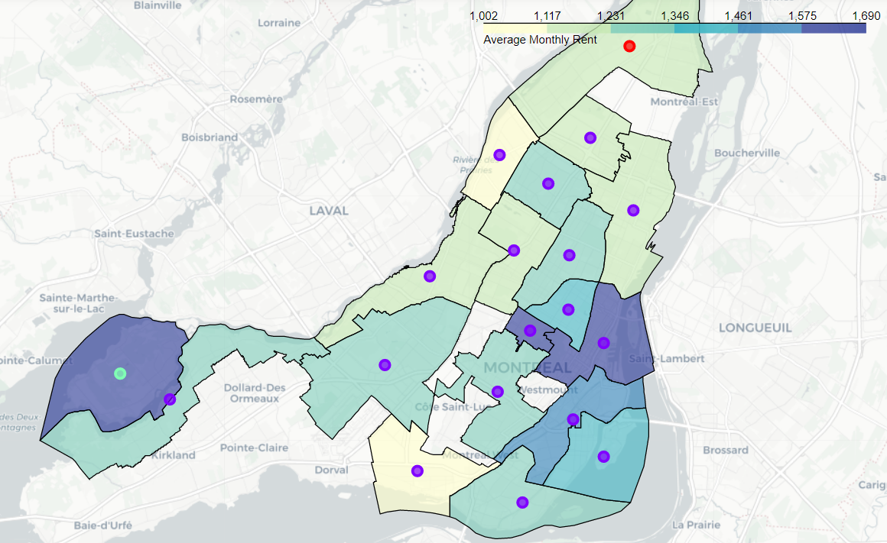
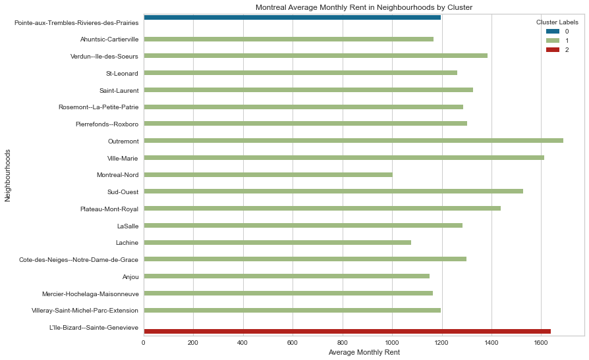
Montreal CLusters

Slide 14
Montreal Clusters
North-East Cluster (Cluster 0)
This cluster encompasses the Pointe-aux-Trembles-Rivieres-des-Prairies neighbourhood. This district seems to be more focused on shopping, with multiple bakeries and markets (Farmers market and Fish market). The rental price for this area is quite reasonable, likely given the distance from the downtown core.
South-West Cluster (Cluster 2)
This cluster includes L'Ile-Bizard--Sainte-Genevieve wherein the top venues are related to recreation (Golf course) and commerce (Construction). The average rental price is quite high in this area, as well.
Central Cluster (Cluster 1)
The remaining neighbourhoods in Montreal can be clustered in near the downtown core. This cluster includes shopping, European style dining, cafes, hotels, and recreational facilities like gyms and spas.

Slide 15
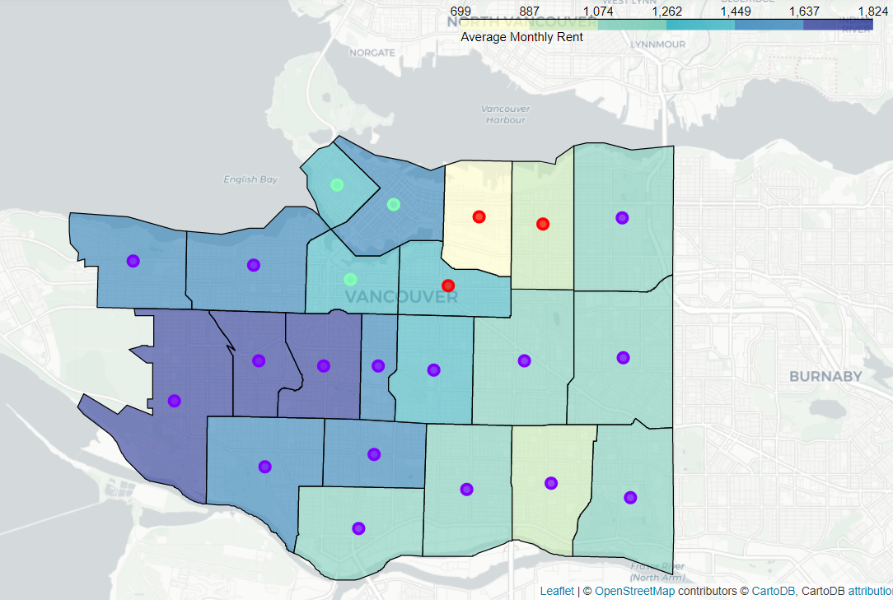
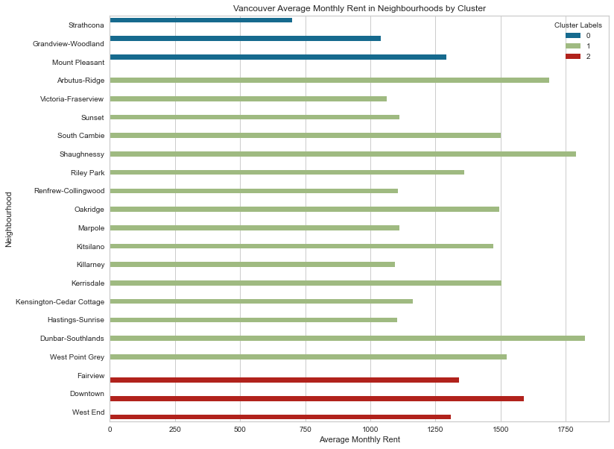
Vancouver Clusters

Slide 16
Vancouver Clusters
Southern Cluster (Cluster 1)
This cluster comprises the majority of Vancouver, including a wide variety of shops, restaurants, and other amenities like banks, gyms and parks. Shaughnessy and Dunbar-Southlands are the most expensive neighbourhoods in Vancouver, but there are others within the cluster that are quite reasonable and have access to similar amenities.
Central Cluster (Cluster 0)
Consisting of 3 neighbourhoods (Strathcona, Grandview-Woodland, and Mount Pleasant), this cluster is the location of many breweries, parks, and small eateries. On average, this is the least expensive area in which to rent in Vancouver.
Downtown-Northern Cluster (Custer 2)
This cluster encompasses the downtown core of Vancouver and it’s surrounding neighbourhoods. As such, this cluster included many hotels, attractions and a variety of restaurants. This cluster is also the most expensive in terms of rental prices on average.

Slide 17
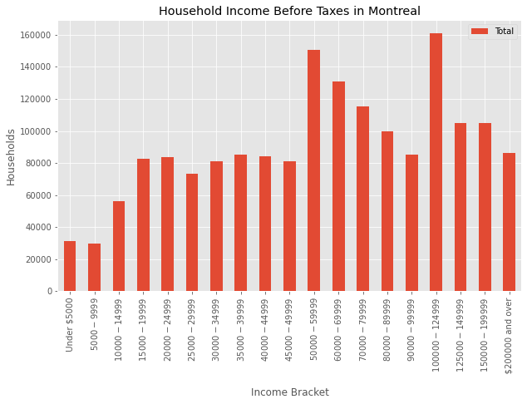
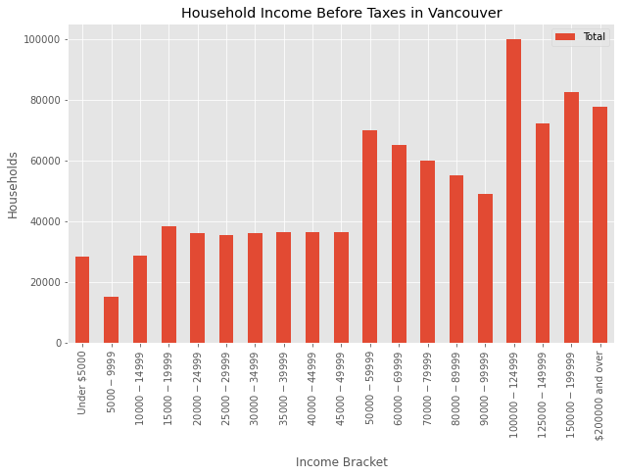
Household Income
Increased proportion of households with incomes over $100,000/year in Vancouver

Slide 18
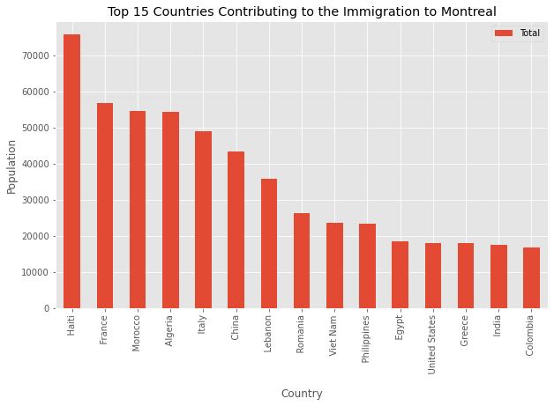
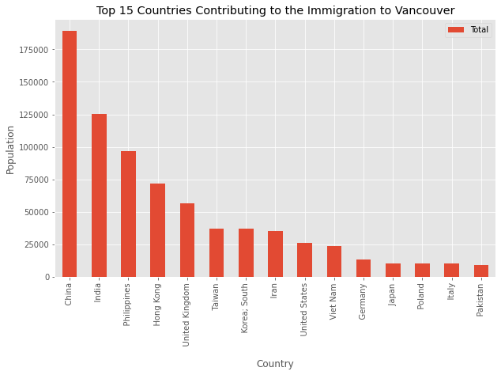
Immigration
Vancouver immigrant population largely from Asia
Montreal immigrant population largely from European and other French-speaking nations

Slide 19
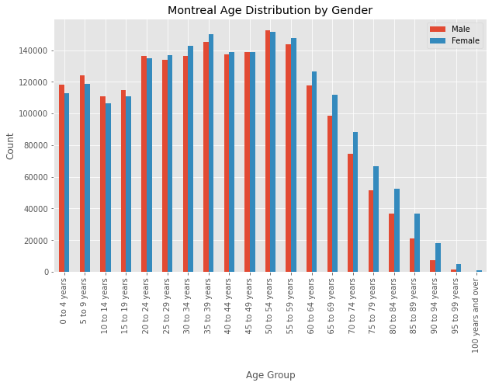
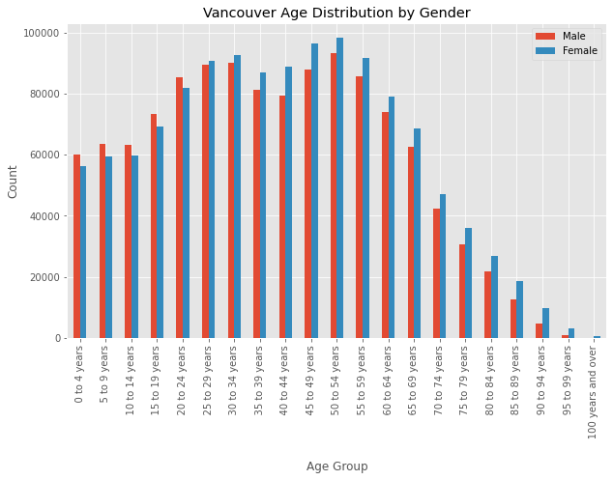
Age and Gender Distribution
Larger proportion of young children (<15 years old) in Montreal
Equal gender distribution in both cities

Slide 20
DIscussion
Neighbourhood Clusters
Both cities provide a large range of amenities throughout the majority of the municipalities, with the exception of small clusters which have more commercial venues.
Rental Costs
Rental costs can depend on numerous factors like neighbourhood amenities (e.g. restaurants and attractions), access to public transportation, views (e.g. waterfront, parks)
Rental prices in both Montreal and Vancouver increase in the downtown core and for waterfront properties
Immigrant Population
In Vancouver there is a large Asian community which can help support new immigrants
Montreal has a large French population from European countries and Haiti
Age and Household Income
Larger proportion of young children (<15 years old) in Montreal implying more families with younger children live in the city
Montreal is likely more affordable, and has more households in the <$100,000 per year income bracket as compared to Vancouver

Slide 21
Conclusion
.
For individuals with moderate incomes and younger families the best choice to move to is Montreal
For tourists:
Montreal has a variety of historical attractions, lower costs, and a variety of dining options such as Italian, Portuguese and French restaurants and bakeries
Vancouver has a large variety of breweries, Asian-type dining options (e.g. Chinese, Japanese, and Vietnamese), and parks

Slide 22
Thank you

